Slide 1
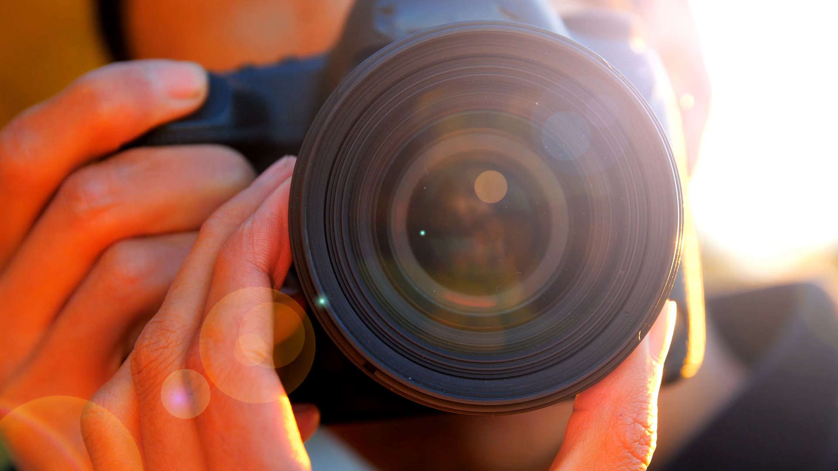
Paparazzi
A face recognition engine
by
Ashraful Firoz
Gaia Castelpietra

Slide 2
OBJECTIVE
This model aims to identify an actor through any photos taken by the user.
This process is done through a few simple steps:
Collecting the data necessary for training the model
Recognizing the face and standardize it
Identifying the actor
Integrate with a simple GUI

Slide 3

Data collection
For each actor, we used 200 images for training and 30 images for validation. This is the perfect compromise between good results and available computing power.
Each image was taken by scrapping DuckDuckGo.

Slide 4
Preprocessing
This step is crucial for the model to be as efficient and accurate as possible.
Preprocessing is divided in four parts:
Using the pretrained Yunet model, we find the face coordinates.
With pretrained FacemarkLBF, we get the eye coordinates.
We warp the image to normalize it using OpenCV.
Finally, we extend the face bounding box to a square shape, crop it and change the resolution to fit the required size (224x224).

Slide 5

Face recognition model
ResNet-50 is a powerful convolutional neural network (CNN).
Depth
Architecture
Shortcut connection
Identity mapping
Normalization
Pre-trained weights
Performance

Slide 6
Final layer
Linear layer 1
Input features
Output features: 1024
Activation: ReLU
Dropout: 50%
Linear layer 2
Input features: 1024
Output features:1024
Activation: ReLU
Dropout: 50%
Linear layer 3
Input features:1024
Output features: n. of classes
Activation: Softmax (applied across the class dimension for probability distribution)

Slide 7

Training
Preload data
Assign numeric value to classes
Augment image
Input data to model
Calculate loss/accuracy
Validate
Repeat 100 times

Slide 8
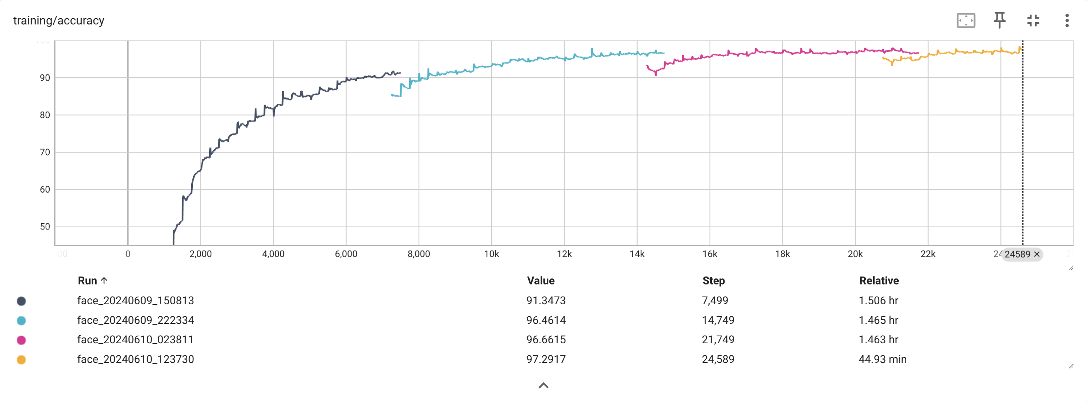
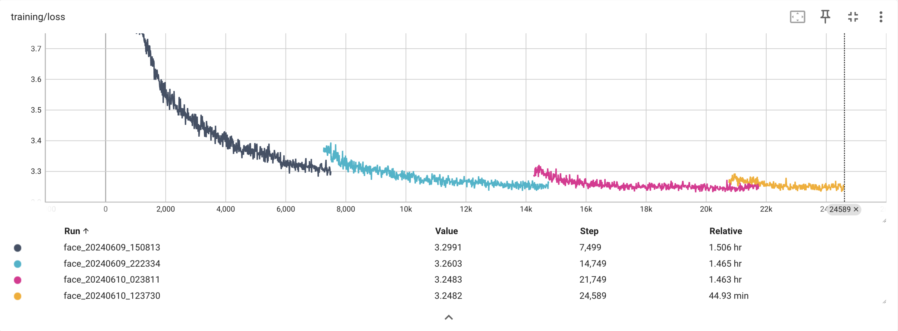
Training batch results

Slide 9
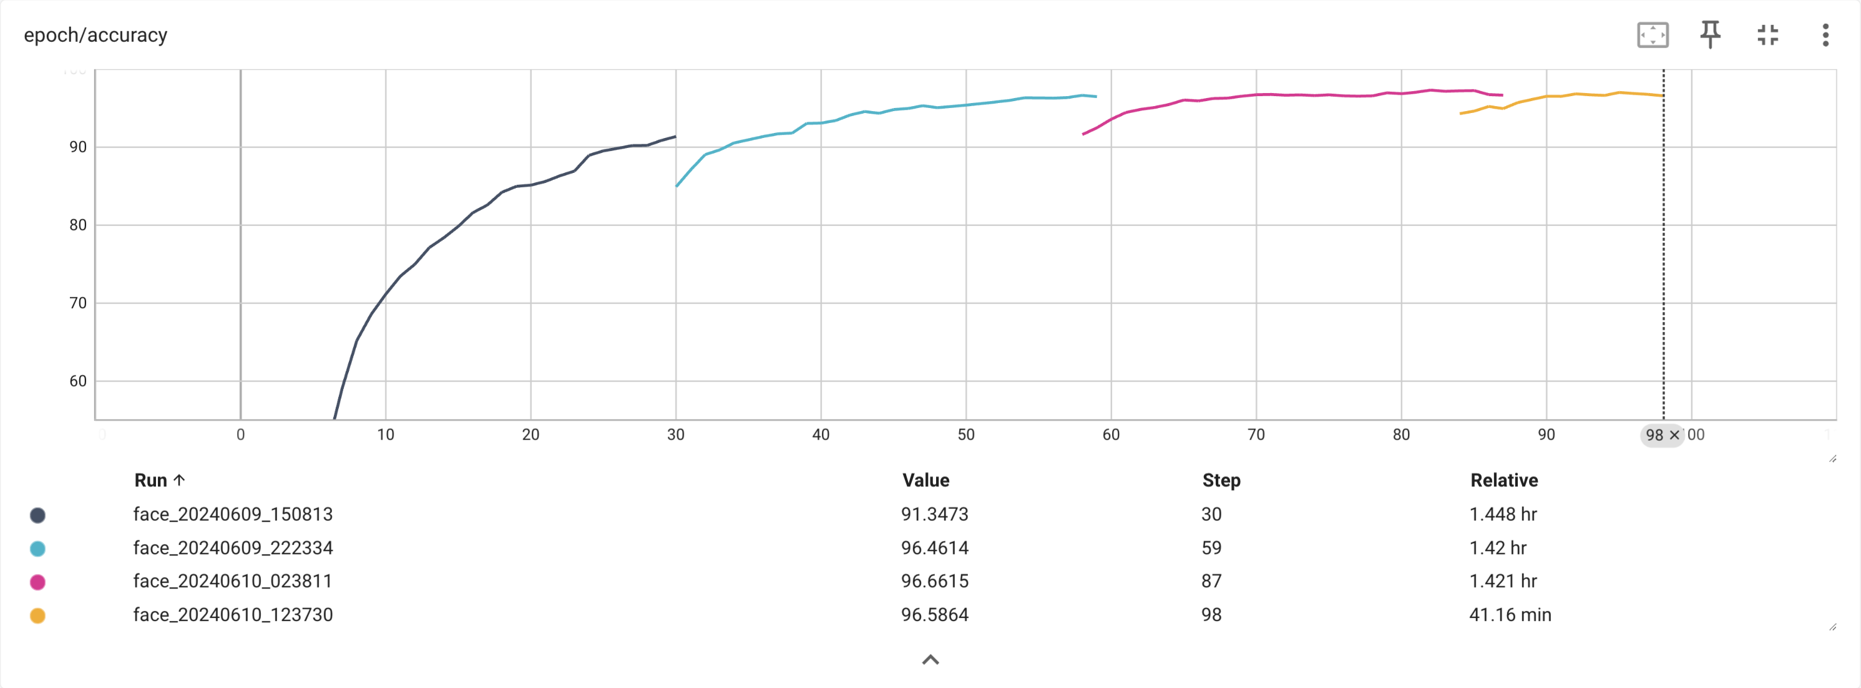
Training epoch results

Slide 10
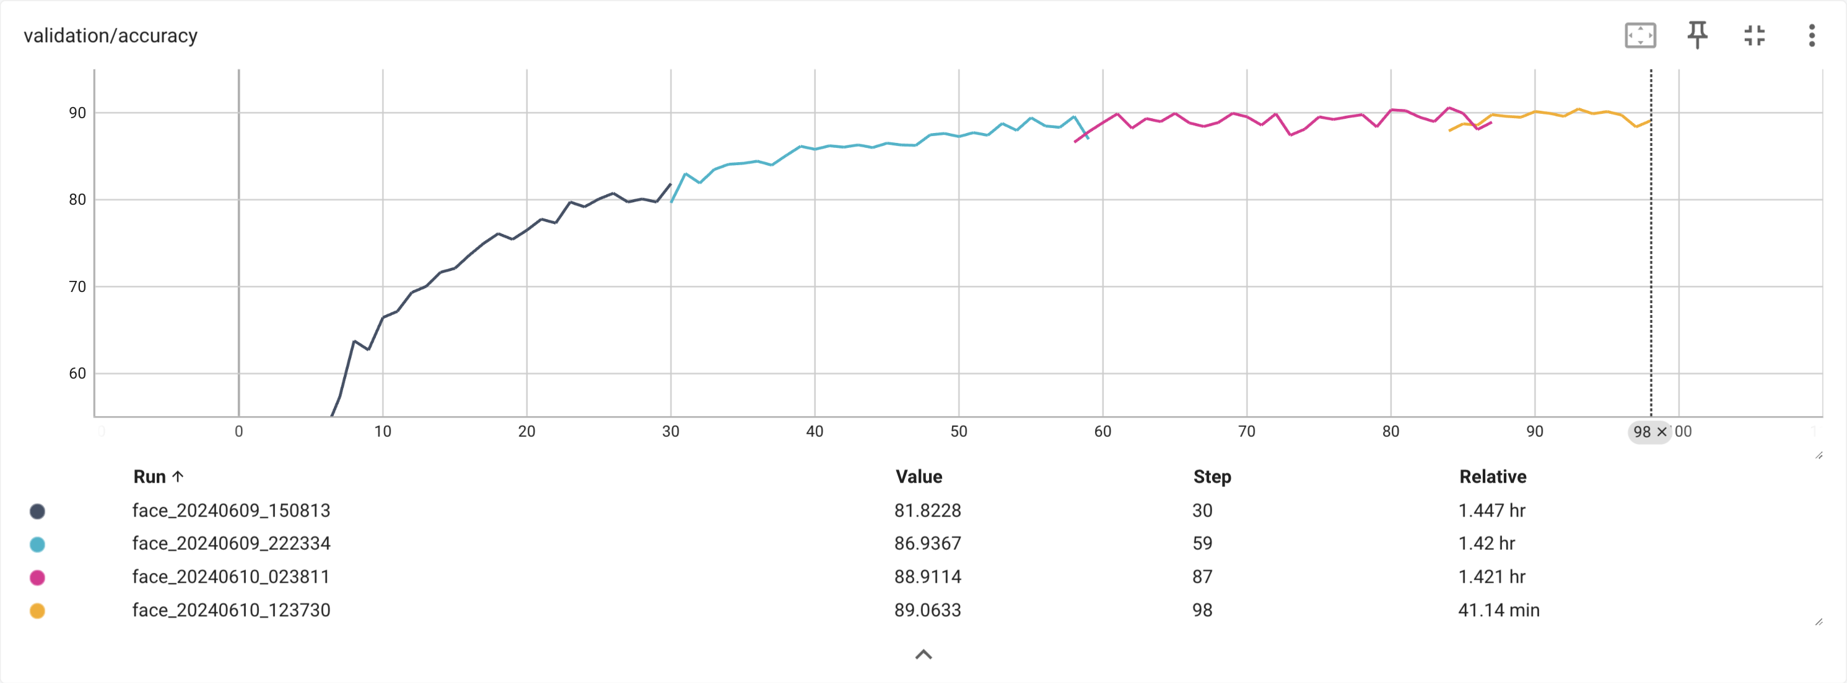
Validation results

Slide 11
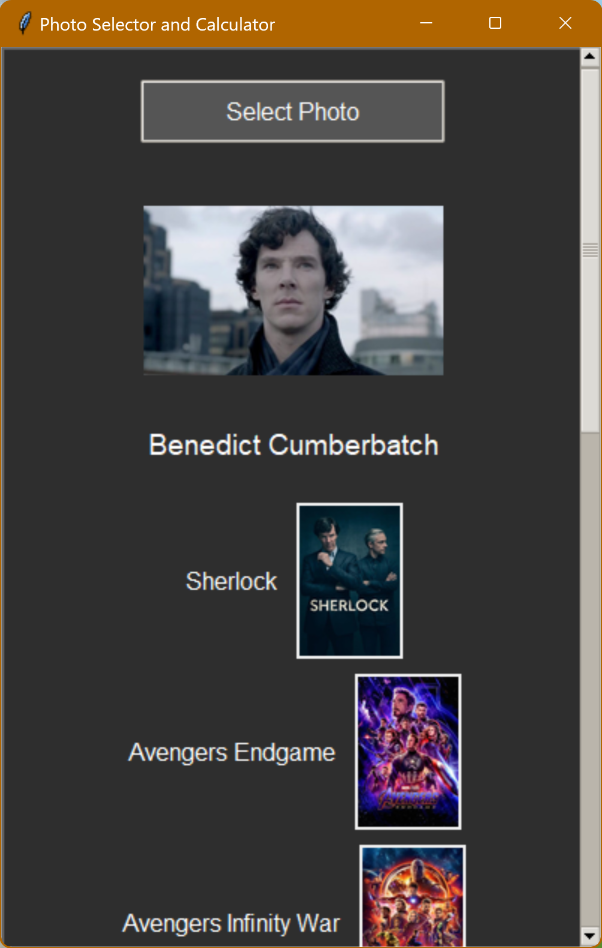
GUI
Very simple design.
A button allows the user to upload any photo and runs it through the model.
After a small buffer, the GUI shows the actor’s name and their best movies and TV series.

Slide 12
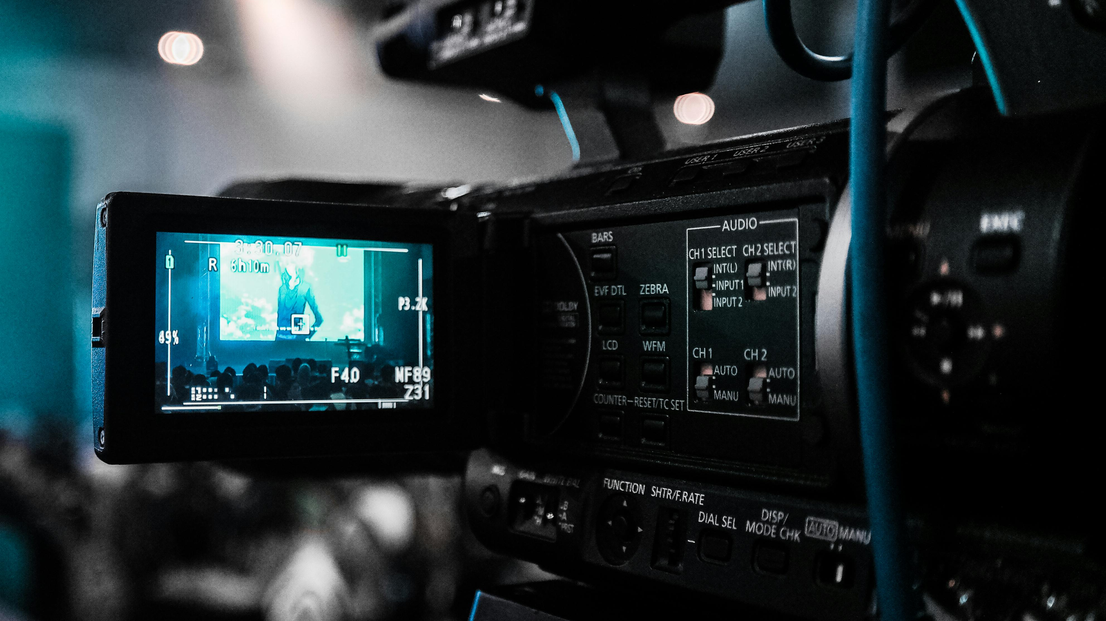
Thank you

